Slide 1

Beyond Stereotypes
Lavanya Vaddavalli Sharadruthi Reddy Muppidi Shwetha Parihar Simon Sazian

Slide 2
Motivation
With the advent of social media in our ever changing world, addressing gender and power imbalances is crucial across various domains.
We recognize the significant impact that portrayals of superheroes in Marvel and DC comics has on children, youth, and adults.
These iconic characters not only entertain but play a pivotal role in shaping societal perceptions of gender roles and power dynamics.
We aim to leverage the capabilities of ML Models, along with various other fairness detection algorithms, to automate hero generation while minimizing bias and promoting creative fairness.
We strive to foster a more equitable representation of gender within the superhero genre, where these iconic figures serve as symbols of inspiration and empowerment.

Slide 3
Problem Introduction
We are working Kaggle's "Superheroes NLP Dataset" curated by Jonathan Besomi.
Provides diverse information on superheroes from various comic books, including Marvel and DC.
81 columns encompassing superhero names, real names, overall scores, history text, gender, superpowers/abilities, and more (~1400 data points).
Relevant to our research, as it provides insights into the current state of gender representation and power dynamics in superhero narratives.
Can be used as labeled training data within our algorithms/fine-tuning our model.

Slide 4
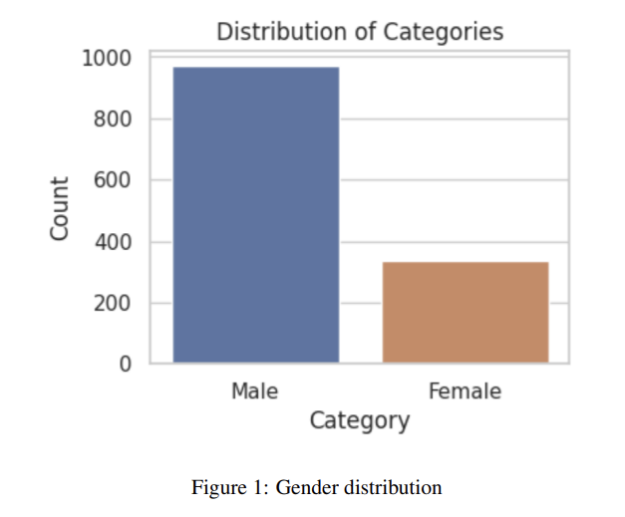
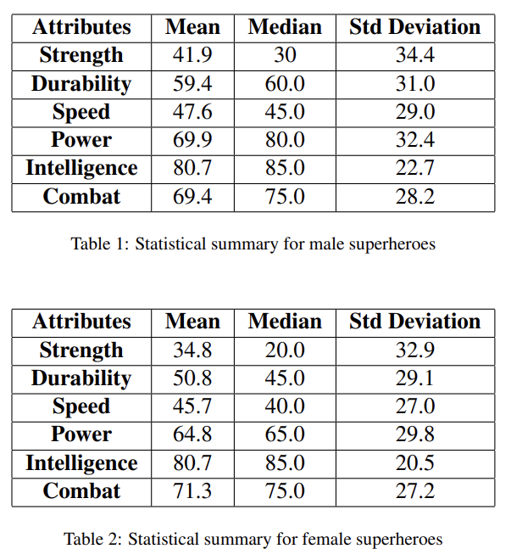
Formalization: gender disparities

Slide 5
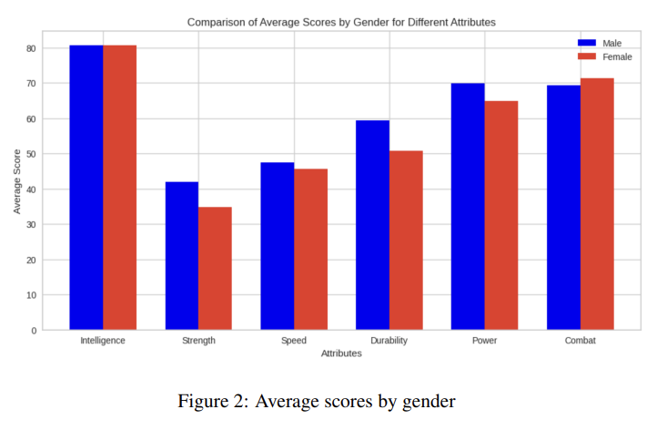
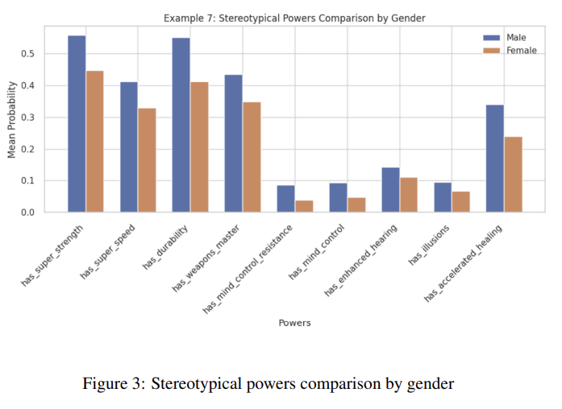
Formalization: gender disparities

Slide 6
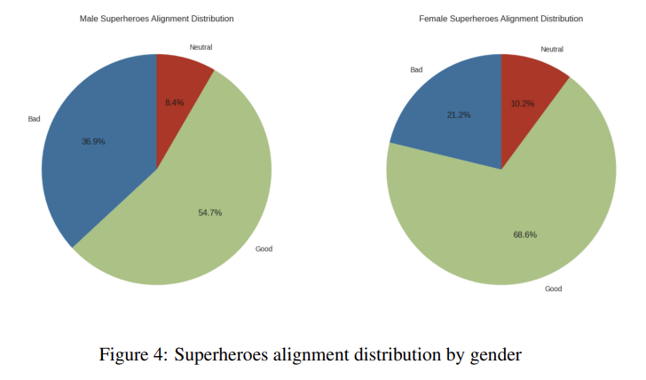
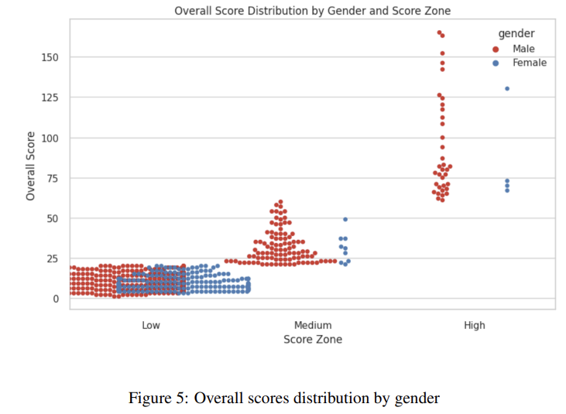
Formalization: gender disparities

Slide 7
Formalization: Models
GPT-2 and Llama2
We experimented with the results obtained from language models like GPT-2 and Llama2 but found it infeasible to fine-tune any language model due to system limitations
GANs
2 components - generator and discriminator. Generator tries to create fake outputs that resemble real data. Discriminator tries to distinguish between real and fake outputs.
Goal is to create outputs that are very realistic and close to the original

Slide 8
Formalization: Models
Variational AutoEncoder
Encoder takes an input and converts it into smaller dense representations, decoder converts it back to original input.
Encoder generates encodings specifically useful for reconstructing its own output.
In the process, it learns useful representations about the data, which we can use to generate new output.

Slide 9
Formalization: Fairness constraints
Gender Parity: equal number of M/F superheroes.
Attribute Distribution: character attributes are balanced between M/F superheroes.
Gender-Neutral Language: avoid using gender-specific terms or stereotypes.
Role Reversal: ensure that male and female superheroes can take on non-traditional roles.
Character Complexity: superheroes of all genders should have multifaceted attributes and backgrounds.
Debiasing Word Embeddings: embeddings do not carry inherent gender biases.
Stereotype Avoidance: avoid perpetuating stereotypes related to M/F superheroes.
Sentiment Fairness: monitor and enforce fairness in sentiment associated with M/F superheroes.

Slide 10
Thank You
Q&A

